Slide 1

StockSmart
Diya Manandhar, Shreyas Regmi, Avash Shrestha, Krishala Pokhrel
Under Supervision of Mr. Sanju Shrestha

Slide 2

Presentation Outline
Introduction & Motivation
Problem Statement
Literature review
Objectives
Methodology
Feasibility
Comparison With Manual system
Gantt Chart & Tech Stack
Conclusion

Slide 3
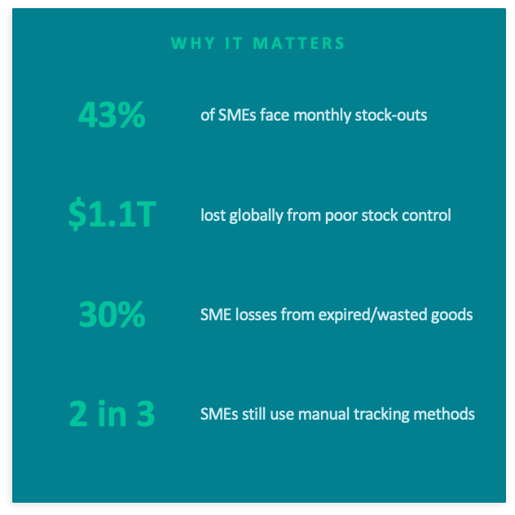
1.INTRODUCTION & MOTIVATION
What is Inventory Management?
•Tracking goods from purchase through to sale
•Covers stock ordering, storage & replenishment
•Core for shops, supermarkets & warehouses
•Directly affects revenue and customer satisfaction

Slide 4
Introduction & Motivation (cont'd)
Who Are SMEs and What Do They Face?
Small Shops
Limited staff; rely on memory or paper logs
Warehouses
Large volumes; manual tracking causes costly errors
Supermarkets
High product variety; expiry tracking is critical
Wholesalers
Seasonal demand spikes lead to over/under-stocking
Why StockSmart is the Answer:
Centralized system – one dashboard for all stock
Real-time updates – no delays or manual entry
Affordable and easy to learn
Designed specifically for SME workflows

Slide 5
2.PROBLEM STATEMENT
Key Challenges Faced by SMEs Today
Stock Shortages
Unable to meet customer demand, resulting in revenue loss
Overstocking
Excess inventory increases storage costs and blocks capital
Expired Products
Lack of tracking leads to wastage and financial loss
No Real-Time Visibility
Stock levels cannot be monitored instantly or accurately
Manual Record Errors
Paper and spreadsheets increase chances of human mistakes

Slide 6
3.LITERATURE REVIEW
Paper 1:Web-Based Inventory Platform for SMEs (Source: Agboola, Malgwi, Mahmud & Oguntoye (2022))
Built a web-based system replacing error-prone spreadsheets with digital records
Includes product tracking, sales management, and user management modules
Demonstrated improved inventory accuracy and reduced operational cost for SMEs
Limitations:
Developed and tested on a single SME — limited generalizability across sectors
Uses the iterative waterfall model — less flexible for changing business requirements
Does not include automated expiry alerts or demand forecasting functionality
Paper 2: ERP Implementation for Supply Chain Management (Source: Qureshi (2022))
Identifies and ranks Critical Success Factors (CSFs) for ERP implementation in supply chains
Uses ISM and MICMAC analysis to model the interdependence between CSFs
Confirms ERP plays a vital role in organizational growth and supply chain sustainability
Limitations:
ERP systems are extremely costly and complex — impractical for small businesses
Long implementation timelines and need for trained IT staff limit accessibility for SMEs
Study focuses on large organizations — findings do not fully translate to small retail shops

Slide 7
LITERATURE REVIEW (cont'd)
Paper 3: IoT-Based Inventory System (Source: Ghulam Haider & Edward Lucas (2024)
IoT-based automated inventory tracking system
Uses sensors for real-time stock monitoring
Reduces manual inventory effort
Limitations:
Requires IoT hardware (sensors/RFID)
High setup and maintenance cost
Technical complexity for SMEs
Paper 4: AI-Based Inventory System (Source: Abdul Majid K & Kavyashree G.J (2025)
Machine learning-based inventory management system
Uses forecasting (Prophet), pattern mining (Apriori), prediction (Random Forest)
Achieves high accuracy in demand prediction (~94%)
Limitations:
Requires large historical datasets
High computational complexity
Does not address expiry-date or batch-level tracking

Slide 8


4.OBJECTIVES
Develop a simple and centralized inventory management
system for SMEs
Provide automated alerts for low stock
and product expiry
Enable real-time inventory tracking, updating,
and transaction recording
Improve accuracy and operational efficiency
in inventory management
Contrast
Reduce losses from overstocking, stock shortages,
and expired products
Lower overhead costs for businesses
through automation
‹#›

Slide 9
5.METHODOLOGY
STEP 1 — Requirement Analysis
Analyze common inventory challenges faced by SMEs
Identify key functional requirements for the system
STEP 2 — Literature Review & Gap Analysis
Study 4 existing inventory management systems
Identify features missing from current solutions
STEP 3 — System Design
Design database schema, user flow, and UI wireframes
Define core modules: inventory, alerts, dashboard, reports
STEP 4 — Feasibility Analysis
Evaluate technical, operational, and economic feasibility
STEP 5 — Development & Testing
Build and test the system for performance and accuracy
Validate with sample data from real SME scenarios

Slide 10
6.FEASIBILITY
The feasibility analysis has been divided into three distinct sections:
Technical:
Tried and tested tech stack with all necessary documentation
Knowhow of much of the tech stack
Simple implementation for SMEs
Mature libraries and APIs for sub-programs
Operational:
Minimal costs associated with operation
Real time inventory-tracking keeps costs low
Integration with E-paper based price labels will reduce operational costs for clients
Economic:
Self-Hosting will eliminate need for VPS, public ip, and/or domain, keeping costs low
“maintainence” will be carried out till bugs are fixed
Open-Source software results in no costs for capable clients

Slide 11
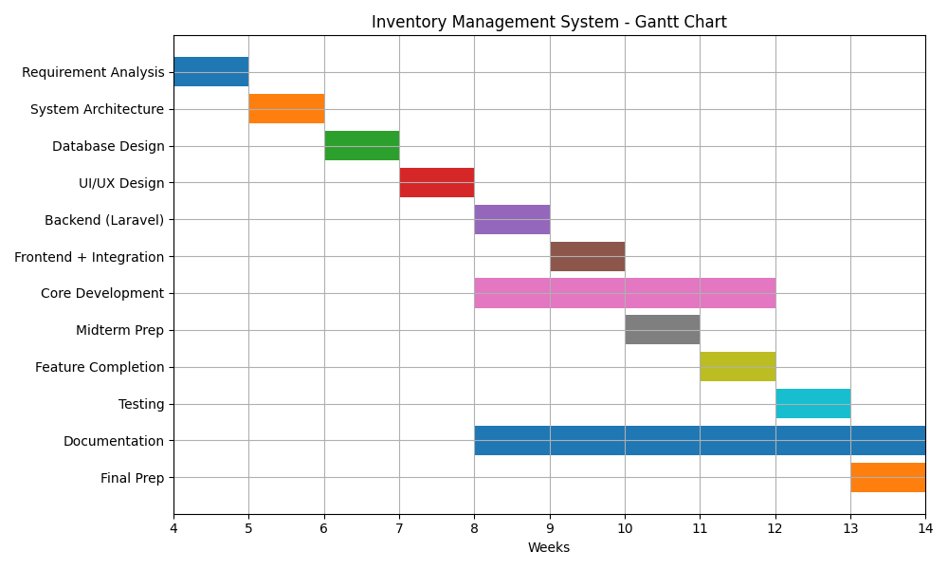
7.GANTT CHART

Slide 12
TECH STACK
Selected the LAMP Tech Stack based on Simplicity and familiarity
L: Linux
A headless linux ISO or a docker image will be used to run the rest of the stack
A: Apache
We will be using an apache web server like XAMPP for development locally
M: MySQL
MySQL will be used for CRUD operations involving the products and their inventorying
P: PHP
Laravel, a PHP framework will be used for backend and integration with MySQL

Slide 13
8.COMPARISON
ERP | StockSmart | Web-Based | IoT-Based | AI-Based | Feature
Very High | Low | Medium | Very High | High | Cost
Very high | Low | Medium | High | High | Complexity
No | No | No | Yes | No | Requires Hardware
No | No | No | No | Yes | Requires Large Data
Low | High | Medium | Medium | Low | Ease of Use
‹#›

Slide 14
9.Conclusion
Replaces manual inventory with a simple digital system
Provides real-time stock tracking and updates
Reduces losses with alerts for low stock and expiry
More affordable and easier than complex systems
Improves efficiency and supports business growth

Slide 15
REFERENCES
F. F. Agboola, Y. M. Malgwi, M. A. Mahmud, and J. P. Oguntoye, "Development of a web-based platform for automating an inventory management of a small and medium enterprise," FUDMA Journal of Sciences (FJS), vol. 6, no. 5, pp. 57–65, Oct. 2022, doi: 10.33003/fjs-2022-0605
G. Haider and E. Lucas, “Smart Inventory Management for SMEs: Leveraging IoT and Automation to Streamline Stock Control and Minimize Costs,” ResearchGate, Dec. 2024. DOI: 10.13140/RG.2.2.33042.57282.
International Journal for Research in Applied Science and Engineering Technology Abdul Majid K and Kavyashree G.J, “Smart Inventory & Sales Analytics for Supermarkets,” International Journal for Research in Applied Science and Engineering Technology (IJRASET), vol. 13, no. 8, pp. 748–757, Aug. 2025, doi: 10.22214/ijraset.2025.73635.
M. R. N. M. Qureshi, "Evaluating enterprise resource planning (ERP) implementation for sustainable supply chain management," Sustainability, vol. 14, no. 22, pp. 1–21, Nov. 2022, doi: 10.3390/su142214779

